Slide 1
DIABETES PREDICTION
AUTHORS:
TANVITHA VADLAMUDI
SAISNEHANJALI SANIKE
VARSHA REDDY VEERATI
CHERISHMA SAMALA
KRISHNA CHAITANYA PALLA

Slide 2
TABLE OF CONTENTS
Project description
Data description
Data attributes
Linear Regression & Profiling
Random forest & Dask
Genetic Algorithm
Dask computation & Grouping

Slide 3
PROJECT DESCRIPTION
The main objective of the project is to forecast a patient's risk of developing diabetes by using their medical history and other health indicators.
By utilizing data from many sources, the goal is to create a model that can help medical practitioners identify diabetes early on, enabling prompt intervention and individualized treatment.

Slide 4
DATA Description
This dataset is a complete tool for comprehending and controlling diabetes risk variables.
This dataset was synthetically generated to resemble real-world health information, covering data from 2021 to 2023.
It includes the number of health indicators that are crucial for predicting and assessing diabetes risk.
The dataset is organized to incorporate lifestyle related characteristics, health measurements, and user demographic information, all of which are essential for determining diabetes risk levels.
It intends to provide a practical value distribution that supports the process of prediction and individualized health advice.

Slide 5
DATA ATTRIBUTES
User ID
Date
Weight
Height
Blood glucose
Physical activity
Diet
Medication adherence
Stress level
Sleep hours
Hydration level
BMI
Risk score, are the columns included in the dataset.

Slide 6
LINEAR REGRESSION & PROFILING

Slide 7
FEATURES
Four features were selected for performing linear regression and to check run time before and after profiling namely,
Weight
bmi
sleep_hours
physical_activity

Slide 8
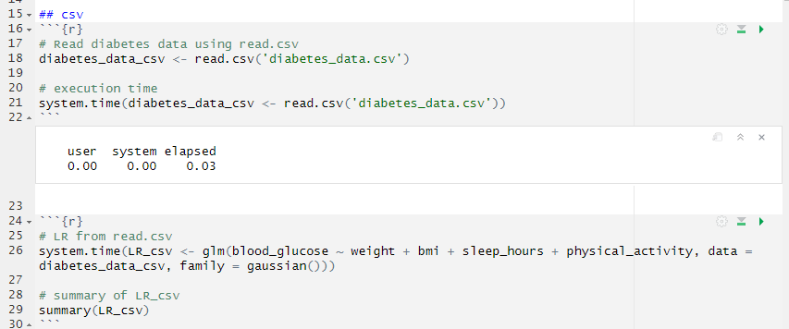
CODE and running time BEFORE PROFILING
Below is the code for LR with read.csv and it took 0.03 seconds for elapsing which is found to be larger than with fread.

Slide 9
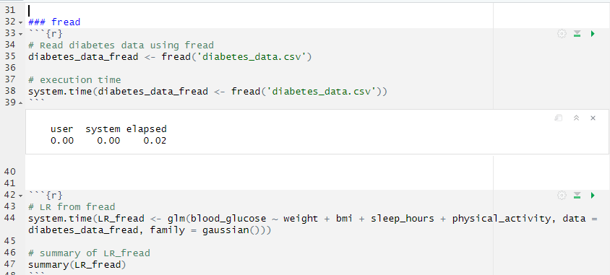
CODE and running time BEFORE PROFILING
Below is the code for LR with fread and it took 0.02 seconds for elapsing which is found to be faster than with read.csv.

Slide 10
IMPORTANCE VALUES
The p-value is found to be greater than 0.05 for weight, bmi, sleep_hours and physical_activity indicating that there is no significant relationship between the blood_glucose and the selected four features.
The p-value of intercept is lesser than 0.05 indicating that it is highly significant, but it alone cannot provide any insights regarding the relationship between the blood_glucose and the weight, bmi, sleep_hours, physical_activity.
Both the read.csv and fread models have same coefficients eventhough they have difference in the time for loading the data. Indicating that there won't be a change in the feature importance values.

Slide 11
RUNNING TIME AFTER PROFILING
Loading the data:
Read.csv:
It took 0.04 seconds for running after profiling for loading the data with read.csv.
fread:
It took 0.02 seconds for running after profiling for loading the data with fread.
This indicated that it took the less time for loading the data with fread.

Slide 12
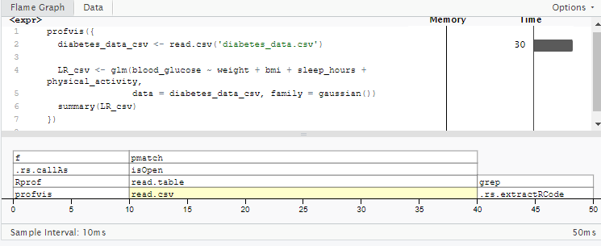
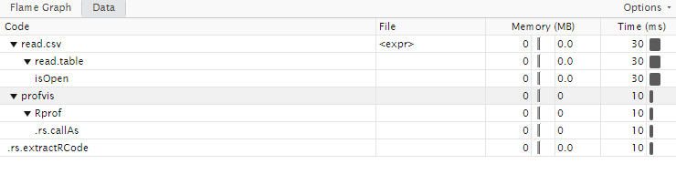
FLAME GRAPH AND DATA TAB
Below is the flame graph and data tab for read.csv after profiling:

Slide 13
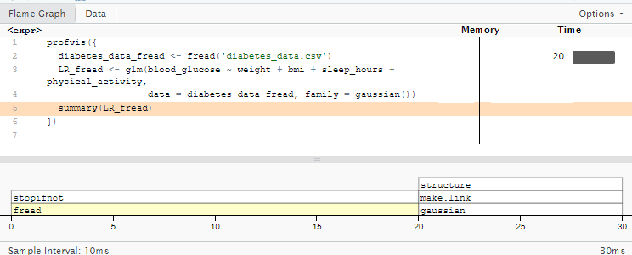
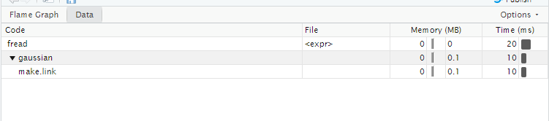
FLAME GRAPH AND DATA TAB
Below is the flame graph and data tab for fread after profiling:

Slide 14
Faster method
Compared to read.csv, the fread model is found to be the faster method as it took lesser execution time.
Benchmarking confirmed that fread model took very less time compared to the read.csv model.

Slide 15
RANDOM FOREST & DASK

Slide 16
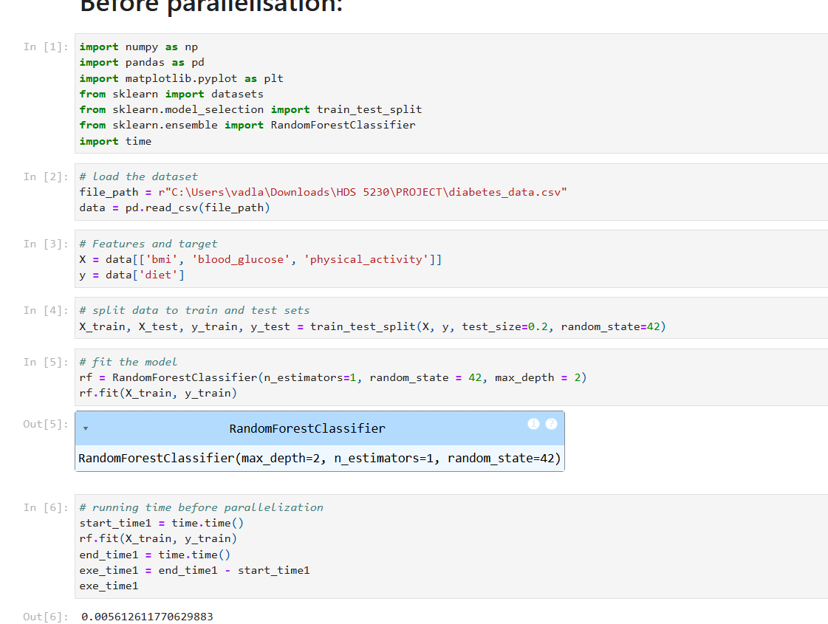
CODE and running time BEFORE PARALLELIZATION
The execution time for fitting the RandomForestClassifier model before parallelization is approximately 0.0056 seconds.

Slide 17
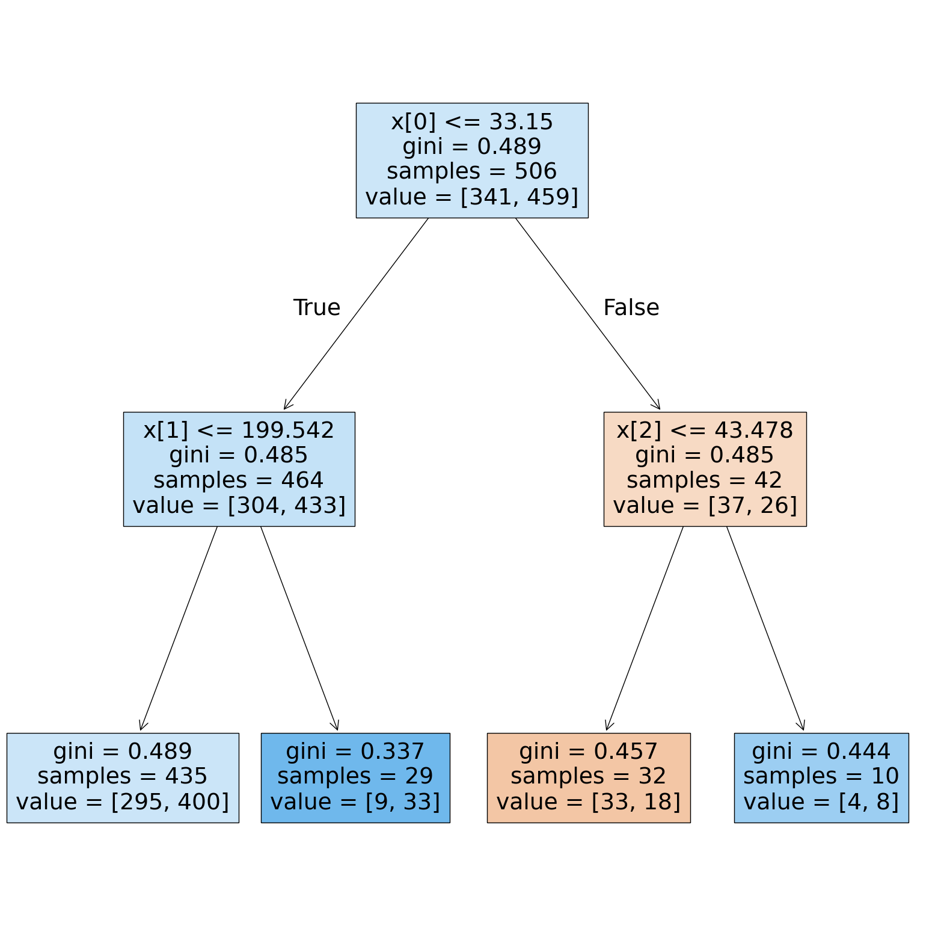

GRAPH
The decision tree visualization shows a categorization model based on three features (x[0], x[1], and x[2]).
The root node divides at x[0] ≤ 33.15, with a Gini impurity of 0.489, indicating some class mixing among 506 samples.
On x[1] ≤ 199.542, the left subtree breaks even more, creating two leaf nodes with varying impurity levels.
There are two new leaf nodes created when the right subtree breaks at x[2] ≤ 43.478.
Improved class separability is suggested by the Gini values across the nodes, which show a decrease in impurity as the tree gets deeper.

Slide 18
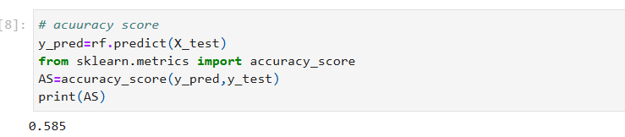
Accuracy score
On the test set, the RandomForest model demonstrated a reasonable level of predictive performance with an accuracy of 0.585.

Slide 19
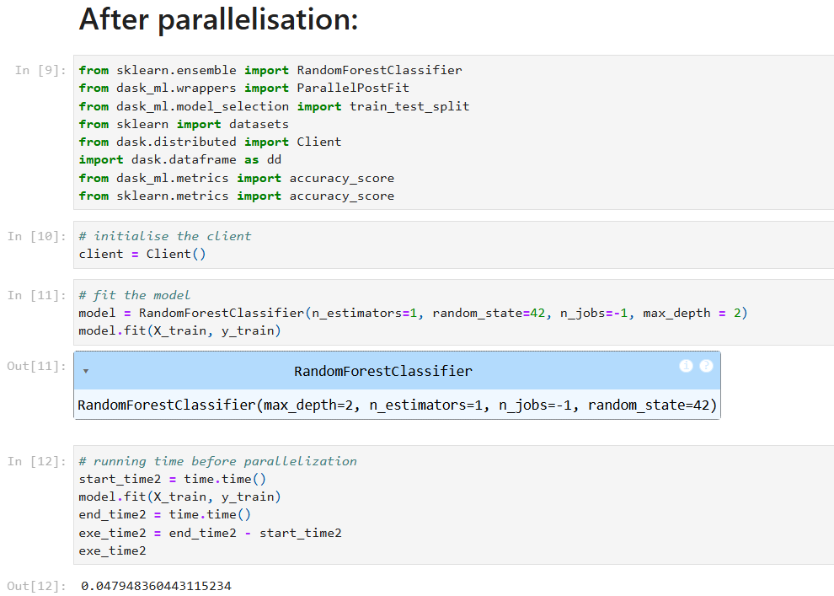
CODE and running time after PARALLELIZATION
The model's execution time increased to 0.0479 seconds after parallelization, suggesting that for this particular scenario, employing several tasks did not enhance performance.

Slide 20

GRAPH
Based on three features, the decision tree divides the dataset, with x[0] as the root (Gini = 0.489, 506 samples).
To progressively reduce impurity, the left node splits on x[1] and the right on x[2].
Some of the terminal nodes have lower Gini indices, which indicate purer subsets, while others display different class distributions.
This structure makes it easier to efficiently classify new data points.

Slide 21
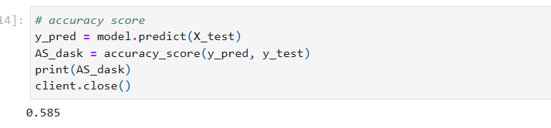
Accuracy score
On the test set, the RandomForest model demonstrated a reasonable level of predictive performance with an accuracy of 0.585.

Slide 22
Faster method
With a training time of just 0.0056 seconds, the Random Forest model was trained far more quickly using rf.fit(X_train, y_train).
However, the model.fit(X_train, y_train) method took 0.0479 seconds to finish.
This indicates that, in this case, the Random Forest model offered a more effective training procedure, maybe as a result of optimized parallelization and variations in implementation.

Slide 23
Genetic algorithm

Slide 24
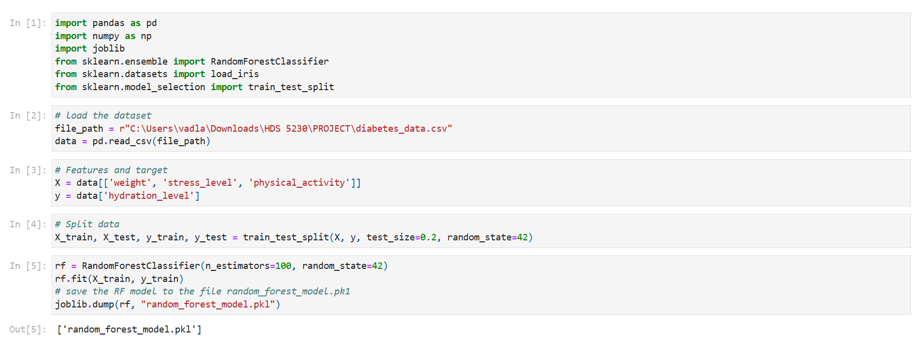
CODE and running time

Slide 25
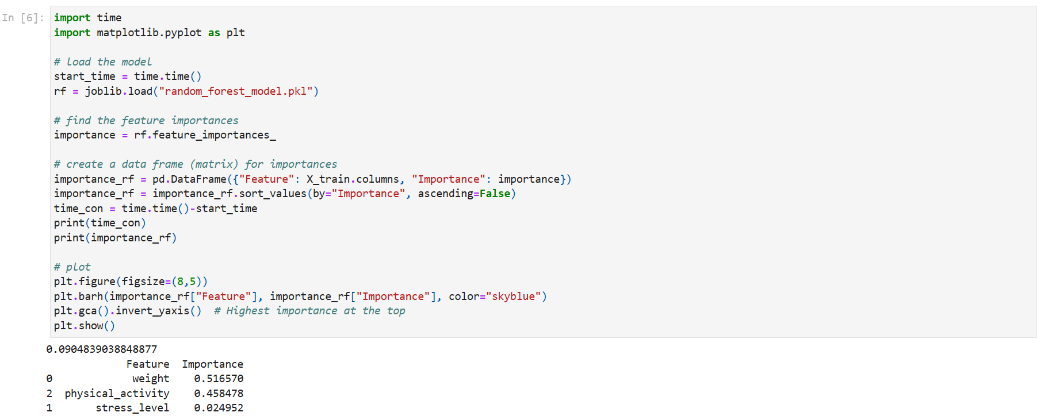

Slide 26
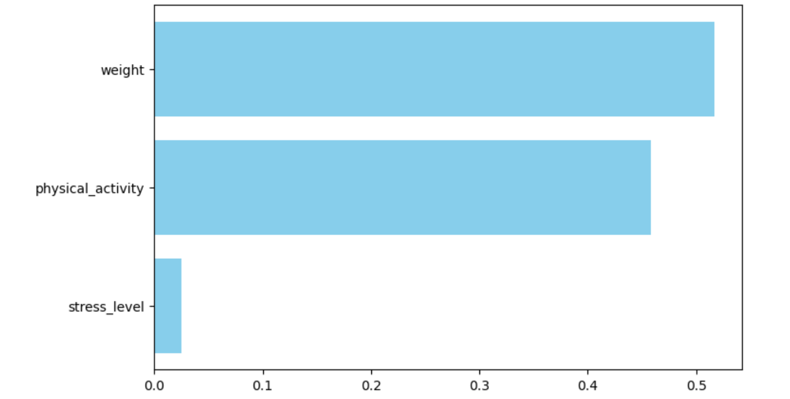
GRAPH
Weight is the most important predictor of hydration level (importance: 0.516).
Physical Activity is the second most important feature (importance: 0.458).
Stress Level has minimal influence on hydration level (importance: 0.025).
This suggests that body weight and physical activity have a much stronger impact on hydration levels compared to stress.

Slide 27
Accuracy score
The accuracy score of the test is found to be 0.605

Slide 28
Dask Computation & Grouping

Slide 29
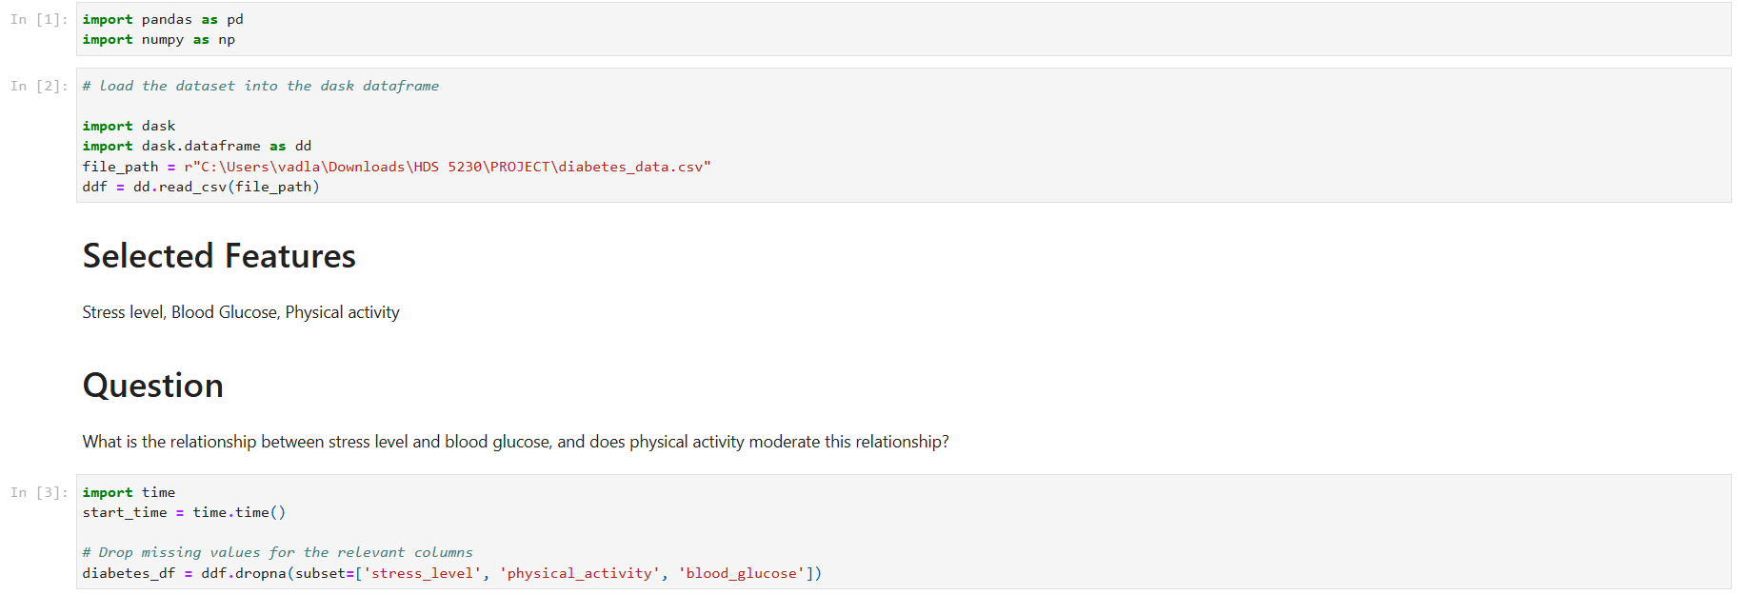
code AND running time

Slide 30
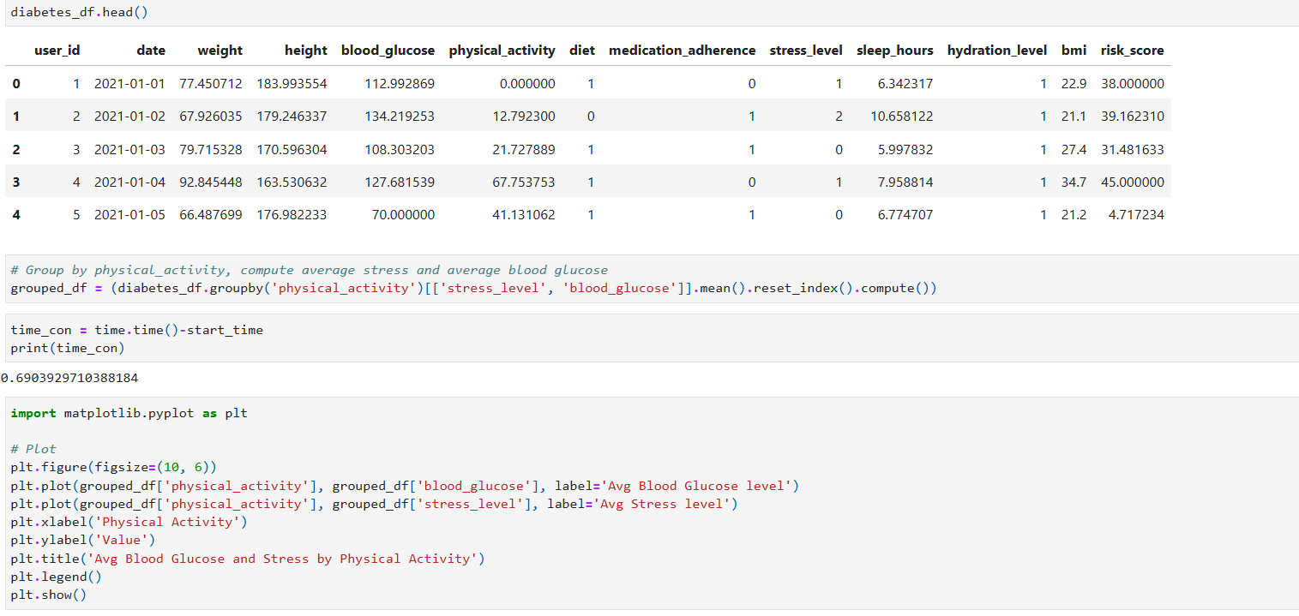

Slide 31
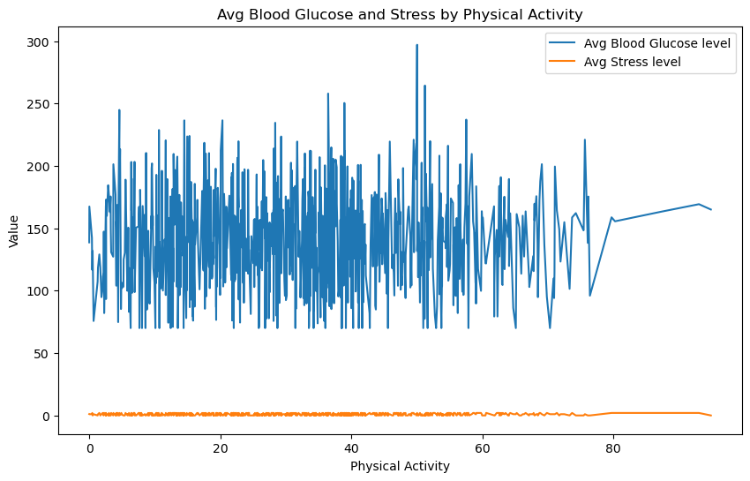
GRAPH

Slide 32
INTERPRETATION
The average stress levels (orange line) clearly demonstrate a declining trend as physical activity increases, suggesting that physical activity consistently reduces stress.
It is challenging to identify a regular pattern because the average blood glucose levels (blue line) exhibit substantial variability with frequent spikes and dips.
At increasing levels of physical activity, blood glucose shows a little downward trend despite the oscillations, which may indicate regulatory effects.

Slide 33
REFERENCES
Simple, M. Diabetes prediction. https://www.kaggle.com/datasets/mrsimple07/diabetes-prediction
Himanshu. Diabetes risk prediction. https://www.kaggle.com/datasets/rcratos/diabetes-risk-prediction/data
Kevintan, K. Diabetes prediction datasets. https://www.kaggle.com/datasets/kevintan701/diabetes-prediction-datasets

Slide 34
THANKYOU

